Slide 1
Morgan and Jack Ground Bass 8L
By Morgan Hughes and Jack Walton

Slide 2
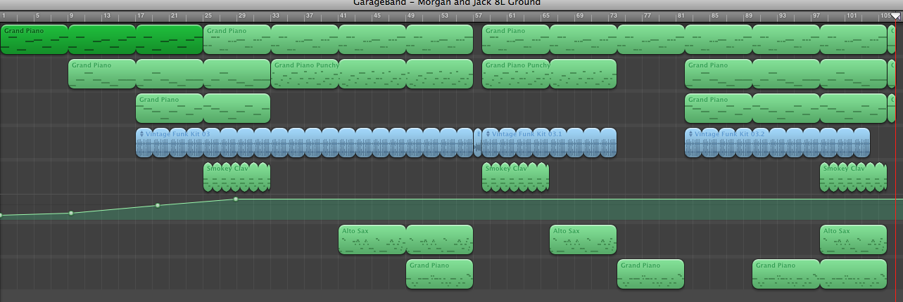
Harmony 1
Harmony 2
Broken Chords
Silence
Ground Bass
Drum Beat
Ostinato
Melody
Counter Melody

Slide 3
Glossary of Terms
Pentatonic Scale = A scale that only includes 5 notes
Ground Bass = A repeating bass line
Ostinato = A repeating pattern
Silence = It adds effect to a piece of Music ( less is more )

Slide 4
Thanks for watching
Hope you have enjoyed our presentation!!!

